Slide 1
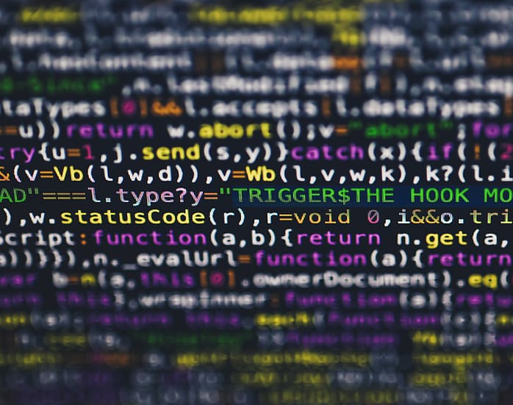
Lucky cafe HTML project
Eisemann Ádám, Balla Máté, Dömötör Bendegúz, Horti Huni

Slide 2
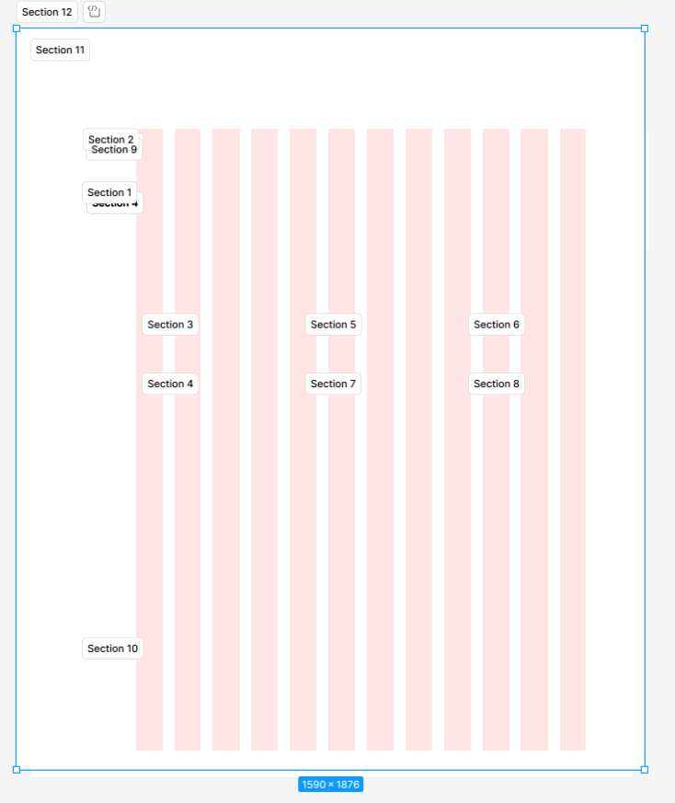
Wireframe
The wireframe is the base of an HTML site. We designed it in Figma.

Slide 3
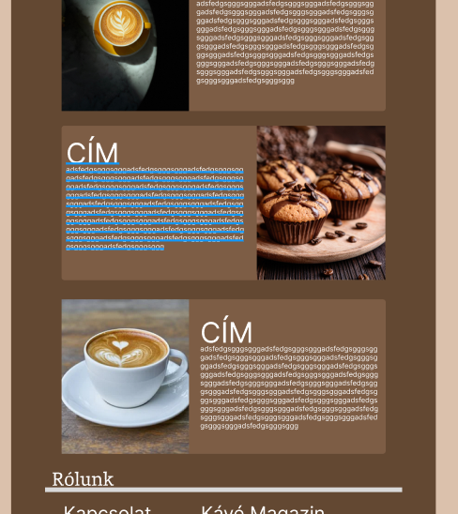
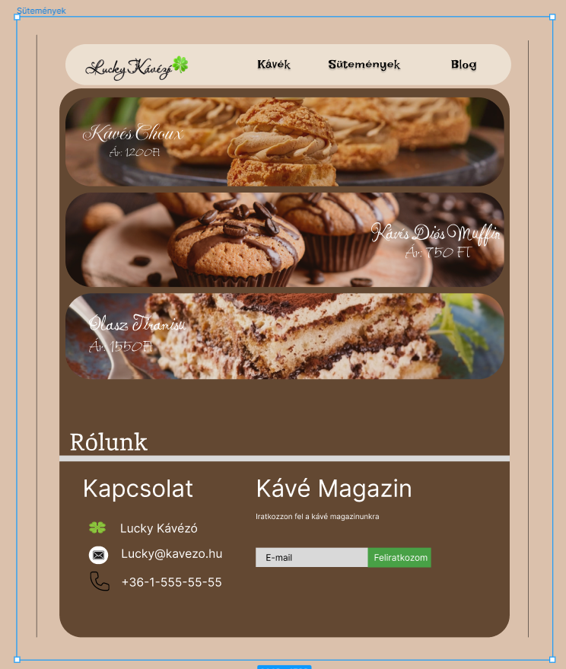
Design ideas

Slide 4
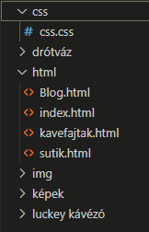
Folder system
We have created a folder system to organize our files. This folder contains the .git folder.

Slide 5
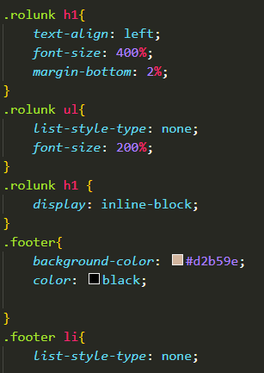
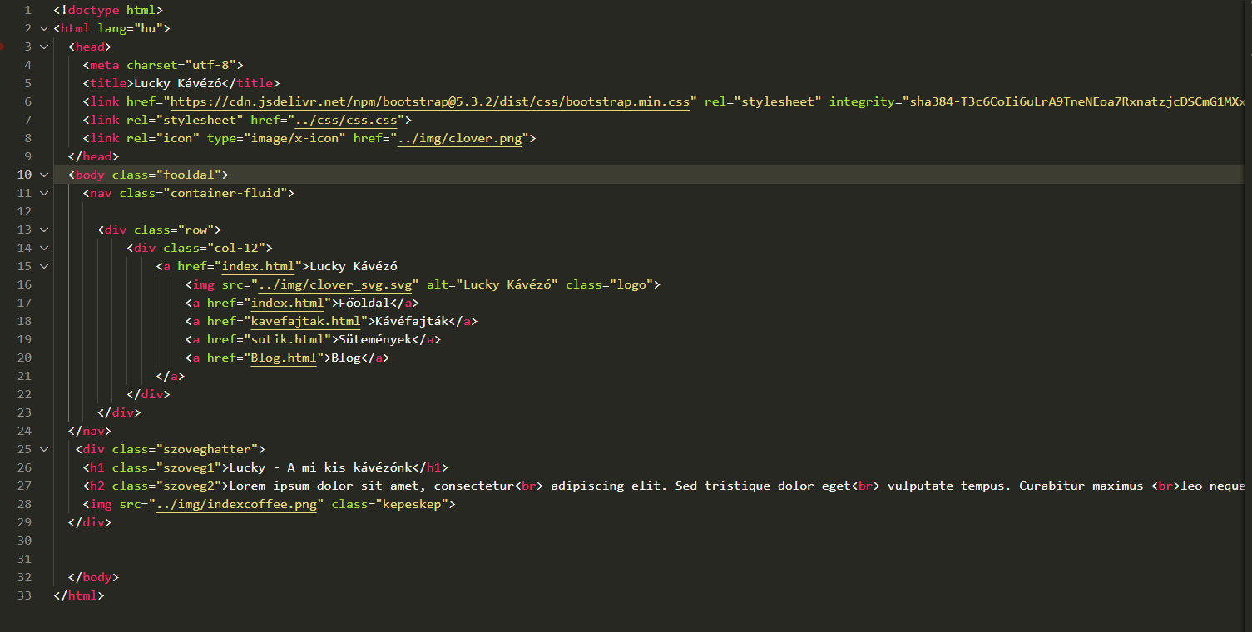
Coding

Slide 6
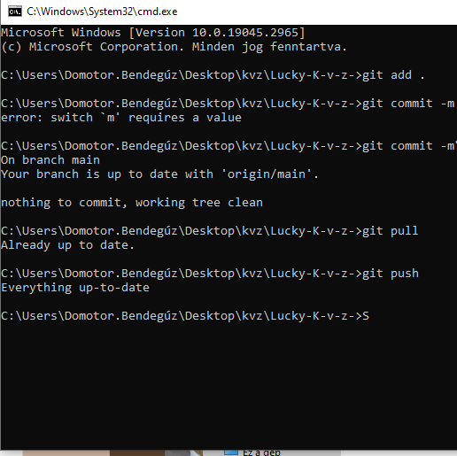
Repository
We upload everything to a GitHub repository, so the files are available from any PC.

Slide 7
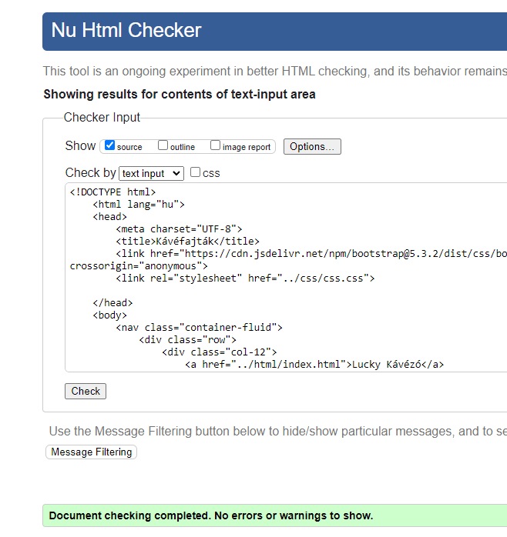
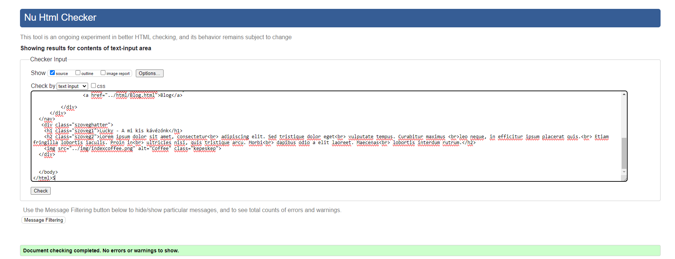
Validation

Slide 8
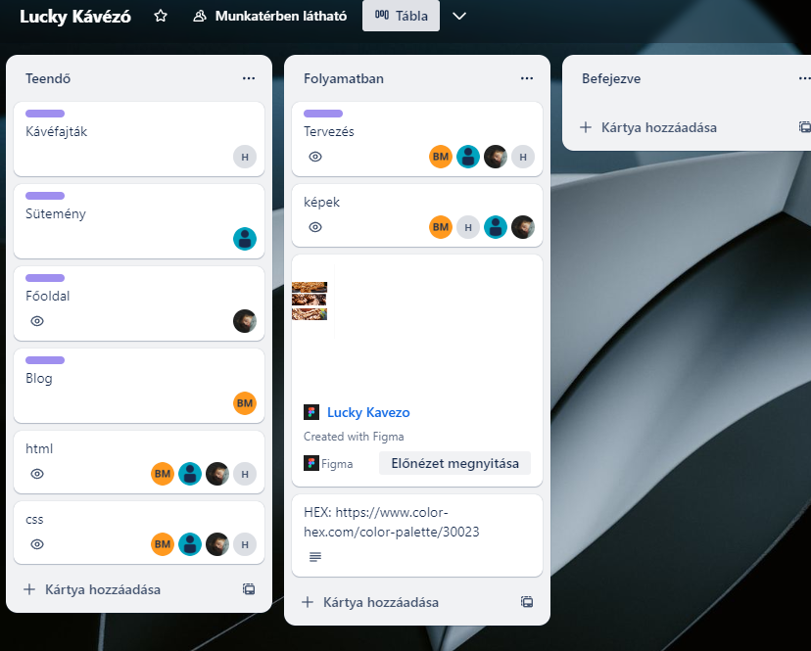
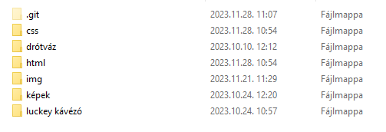
Summary
Overall, this project taught us to use online programs such as Trello and Figma. The team had difficulties at first, but we got together and figured everything out.

